Slide 1
Chapter 6
Storage and Other I/O Topics

Slide 2
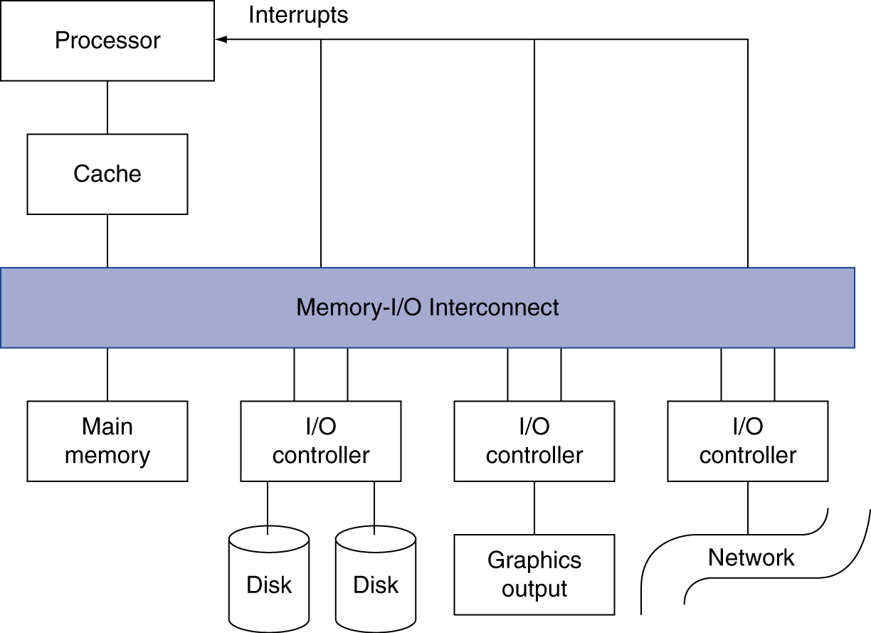
Introduction
§6.1 Introduction
I/O devices can be characterized by
  Behaviour: input, output, storage
  Partner: human or machine
  Data rate: bytes/sec, transfers/sec
I/O bus connections

Slide 3
I/O System Characteristics
Dependability is important
  Particularly for storage devices
Performance measures
  Latency (response time)
  Throughput (bandwidth)
  Desktops & embedded systems
    Mainly interested in response time & diversity of devices
  Servers
    Mainly interested in throughput & expandability of devices

Slide 4
Dependability
Service accomplishment
Service delivered
as specified
§6.2 Dependability, Reliability, and Availability
Fault: failure of a component
  May or may not lead to system failure
Restoration
Failure
Service interruption
Deviation from
specified service

Slide 5
Dependability Measures
Reliability: mean time to failure (MTTF)
Service interruption: mean time to repair (MTTR)
Mean time between failures
  MTBF = MTTF + MTTR
Availability = MTTF / (MTTF + MTTR)
Improving Availability
  Increase MTTF: fault avoidance, fault tolerance, fault forecasting
  Reduce MTTR: improved tools and processes for diagnosis and repair

Slide 6
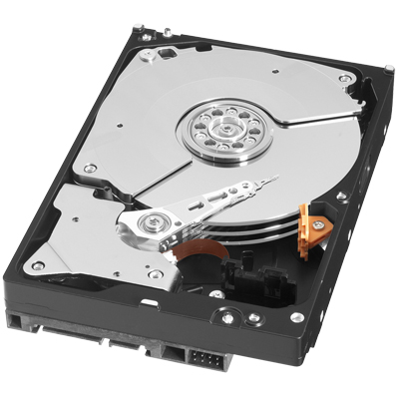

Disk Storage
§6.3 Disk Storage
Nonvolatile, rotating magnetic storage

Slide 7
Disk Sectors and Access
Each sector records
  Sector ID
  Data (512 bytes, 4096 bytes proposed)
  Error correcting code (ECC)
    Used to hide defects and recording errors
  Synchronization fields and gaps
Access to a sector involves
  Queuing delay if other accesses are pending
  Seek: move the heads
  Rotational latency
  Data transfer
  Controller overhead

Slide 8
Disk Access Example
Given
  512B sector, 15,000rpm, 4ms average seek time, 100MB/s transfer rate, 0.2ms controller overhead, idle disk
Average read time
  4ms seek time
  + ½ / (15,000/60) = 2ms rotational latency
  + 512 / 100MB/s = 0.005ms transfer time
  + 0.2ms controller delay
  = 6.2ms
If actual average seek time is 1ms
  Average read time = 3.2ms

Slide 9
Disk Performance Issues
Manufacturers quote average seek time
  Based on all possible seeks
  Locality and OS scheduling lead to smaller actual average seek times
Smart disk controller allocate physical sectors on disk
  Present logical sector interface to host
  SCSI, ATA, SATA
Disk drives include caches
  Prefetch sectors in anticipation of access
  Avoid seek and rotational delay

Slide 10


Flash Storage
§6.4 Flash Storage
Nonvolatile semiconductor storage
  100× – 1000× faster than disk
  Smaller, lower power, more robust
  But more $/GB (between disk and DRAM)

Slide 11
Flash Types
NOR flash: bit cell like a NOR gate
  Random read/write access
  Used for instruction memory in embedded systems
NAND flash: bit cell like a NAND gate
  Denser (bits/area), but block-at-a-time access
  Cheaper per GB
  Used for USB keys, media storage, …
Flash bits wears out after 1000’s of accesses
  Not suitable for direct RAM or disk replacement
  Wear leveling: remap data to less used blocks

Slide 12
Interconnecting Components
Need interconnections between
  CPU, memory, I/O controllers
Bus: shared communication channel
  Parallel set of wires for data and synchronization of data transfer
  Can become a bottleneck
Performance limited by physical factors
  Wire length, number of connections
More recent alternative: high-speed serial connections with switches
  Like networks
§6.5 Connecting Processors, Memory, and I/O Devices

Slide 13
Bus Types
Processor-Memory buses
  Short, high speed
  Design is matched to memory organization
I/O buses
  Longer, allowing multiple connections
  Specified by standards for interoperability
  Connect to processor-memory bus through a bridge

Slide 14
Bus Signals and Synchronization
Data lines
  Carry address and data
  Multiplexed or separate
Control lines
  Indicate data type, synchronize transactions
Synchronous
  Uses a bus clock
Asynchronous
  Uses request/acknowledge control lines for handshaking

Slide 15
I/O Bus Examples
 | Firewire | USB 2.0 | PCI Express | Serial ATA | Serial Attached SCSI
Intended use | External | External | Internal | Internal | External
Devices per channel | 63 | 127 | 1 | 1 | 4
Data width | 4 | 2 | 2/lane | 4 | 4
Peak bandwidth | 50MB/s or 100MB/s | 0.2MB/s, 1.5MB/s, or 60MB/s | 250MB/s/lane 1×, 2×, 4×, 8×, 16×, 32× | 300MB/s | 300MB/s
Hot pluggable | Yes | Yes | Depends | Yes | Yes
Max length | 4.5m | 5m | 0.5m | 1m | 8m
Standard | IEEE 1394 | USB Implementers Forum | PCI-SIG | SATA-IO | INCITS TC T10

Slide 16
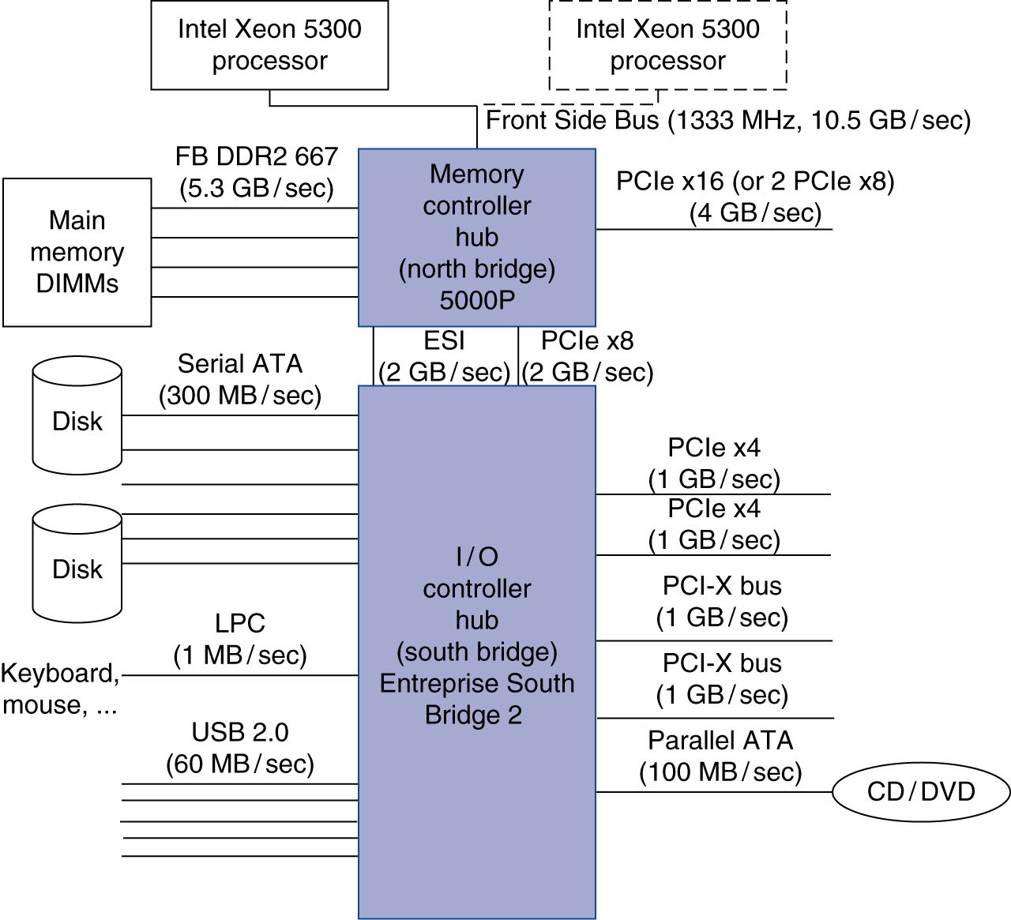
Typical x86 PC I/O System

Slide 17
I/O Management
I/O is mediated by the OS
  Multiple programs share I/O resources
    Need protection and scheduling
  I/O causes asynchronous interrupts
    Same mechanism as exceptions
  I/O programming is fiddly
    OS provides abstractions to programs
§6.6 Interfacing I/O Devices …

Slide 18
I/O Commands
I/O devices are managed by I/O controller hardware
  Transfers data to/from device
  Synchronizes operations with software
Command registers
  Cause device to do something
Status registers
  Indicate what the device is doing and occurrence of errors
Data registers
  Write: transfer data to a device
  Read: transfer data from a device

Slide 19
I/O Register Mapping
Memory mapped I/O
  Registers are addressed in same space as memory
  Address decoder distinguishes between them
  OS uses address translation mechanism to make them only accessible to kernel
I/O instructions
  Separate instructions to access I/O registers
  Can only be executed in kernel mode
  Example: x86

Slide 20
Polling
Periodically check I/O status register
  If device ready, do operation
  If error, take action
Common in small or low-performance real-time embedded systems
  Predictable timing
  Low hardware cost
In other systems, wastes CPU time

Slide 21
Interrupts
When a device is ready or error occurs
  Controller interrupts CPU
Interrupt is like an exception
  But not synchronized to instruction execution
  Can invoke handler between instructions
  Cause information often identifies the interrupting device
Priority interrupts
  Devices needing more urgent attention get higher priority
  Can interrupt handler for a lower priority interrupt

Slide 22
I/O Data Transfer
Polling and interrupt-driven I/O
  CPU transfers data between memory and I/O data registers
  Time consuming for high-speed devices
Direct memory access (DMA)
  OS provides starting address in memory
  I/O controller transfers to/from memory autonomously
  Controller interrupts on completion or error

Slide 23
DMA/Cache Interaction
If DMA writes to a memory block that is cached
  Cached copy becomes stale
If write-back cache has dirty block, and DMA reads memory block
  Reads stale data
Need to ensure cache coherence
  Flush blocks from cache if they will be used for DMA
  Or use non-cacheable memory locations for I/O

Slide 24
DMA/VM Interaction
OS uses virtual addresses for memory
  DMA blocks may not be contiguous in physical memory
Should DMA use virtual addresses?
  Would require controller to do translation
If DMA uses physical addresses
  May need to break transfers into page-sized chunks
  Or chain multiple transfers
  Or allocate contiguous physical pages for DMA

Slide 25
Measuring I/O Performance
I/O performance depends on
  Hardware: CPU, memory, controllers, buses
  Software: operating system, database management system, application
  Workload: request rates and patterns
I/O system design can trade-off between response time and throughput
  Measurements of throughput often done with constrained response-time
§6.7 I/O Performance Measures: …

Slide 26
Transaction Processing Benchmarks
Transactions
  Small data accesses to a DBMS
  Interested in I/O rate, not data rate
Measure throughput
  Subject to response time limits and failure handling
  ACID (Atomicity, Consistency, Isolation, Durability)
  Overall cost per transaction
Transaction Processing Council (TPC) benchmarks (www.tcp.org)
  TPC-APP: B2B application server and web services
  TCP-C: on-line order entry environment
  TCP-E: on-line transaction processing for brokerage firm
  TPC-H: decision support — business oriented ad-hoc queries

Slide 27
File System & Web Benchmarks
SPEC System File System (SFS)
  Synthetic workload for NFS server, based on monitoring real systems
  Results
    Throughput (operations/sec)
    Response time (average ms/operation)
SPEC Web Server benchmark
  Measures simultaneous user sessions, subject to required throughput/session
  Three workloads: Banking, Ecommerce, and Support

Slide 28
I/O vs. CPU Performance
Amdahl’s Law
  Don’t neglect I/O performance as parallelism increases compute performance
Example
  Benchmark takes 90s CPU time, 10s I/O time
  Double the number of CPUs/2 years
    I/O unchanged
§6.9 Parallelism and I/O: RAID
Year | CPU time | I/O time | Elapsed time | % I/O time
now | 90s | 10s | 100s | 10%
+2 | 45s | 10s | 55s | 18%
+4 | 23s | 10s | 33s | 31%
+6 | 11s | 10s | 21s | 47%

Slide 29
RAID
Redundant Array of Inexpensive (Independent) Disks
  Use multiple smaller disks (c.f. one large disk)
  Parallelism improves performance
  Plus extra disk(s) for redundant data storage
Provides fault tolerant storage system
  Especially if failed disks can be “hot swapped”
RAID 0
  No redundancy (“AID”?)
    Just stripe data over multiple disks
  But it does improve performance

Slide 30
RAID 1 & 2
RAID 1: Mirroring
  N + N disks, replicate data
    Write data to both data disk and mirror disk
    On disk failure, read from mirror
RAID 2: Error correcting code (ECC)
  N + E disks (e.g., 10 + 4)
  Split data at bit level across N disks
  Generate E-bit ECC
  Too complex, not used in practice

Slide 31
RAID 3: Bit-Interleaved Parity
N + 1 disks
  Data striped across N disks at byte level
  Redundant disk stores parity
  Read access
    Read all disks
  Write access
    Generate new parity and update all disks
  On failure
    Use parity to reconstruct missing data
Not widely used

Slide 32
RAID 4: Block-Interleaved Parity
N + 1 disks
  Data striped across N disks at block level
  Redundant disk stores parity for a group of blocks
  Read access
    Read only the disk holding the required block
  Write access
    Just read disk containing modified block, and parity disk
    Calculate new parity, update data disk and parity disk
  On failure
    Use parity to reconstruct missing data
Not widely used

Slide 33
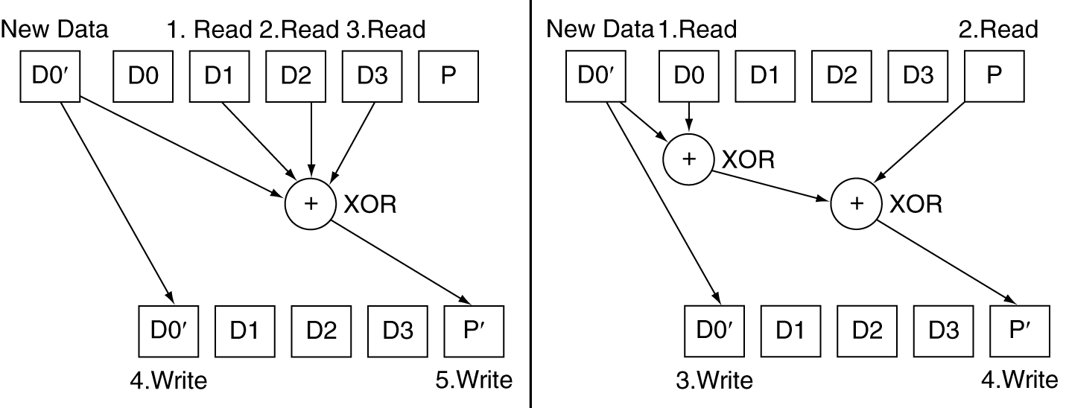
RAID 3 vs RAID 4

Slide 34
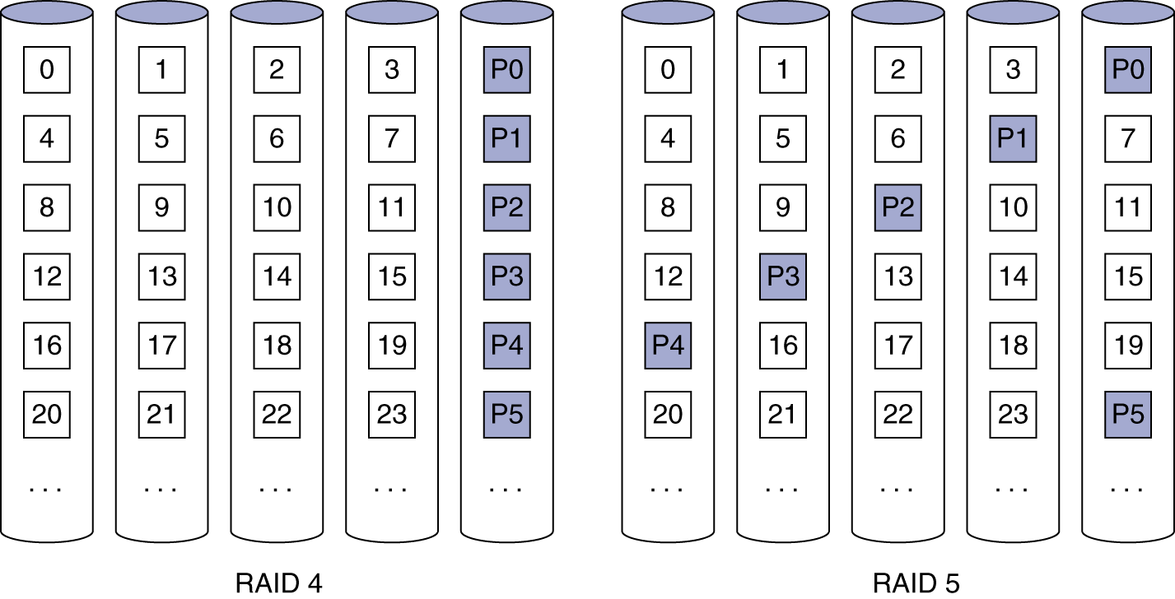
RAID 5: Distributed Parity
N + 1 disks
  Like RAID 4, but parity blocks distributed across disks
    Avoids parity disk being a bottleneck
Widely used

Slide 35
RAID 6: P + Q Redundancy
N + 2 disks
  Like RAID 5, but two lots of parity
  Greater fault tolerance through more redundancy
Multiple RAID
  More advanced systems give similar fault tolerance with better performance

Slide 36
RAID Summary
RAID can improve performance and availability
  High availability requires hot swapping
Assumes independent disk failures
  Too bad if the building burns down!
See “Hard Disk Performance, Quality and Reliability”
  http://www.pcguide.com/ref/hdd/perf/index.htm

Slide 37
I/O System Design
Satisfying latency requirements
  For time-critical operations
  If system is unloaded
    Add up latency of components
Maximizing throughput
  Find “weakest link” (lowest-bandwidth component)
  Configure to operate at its maximum bandwidth
  Balance remaining components in the system
If system is loaded, simple analysis is insufficient
  Need to use queuing models or simulation
§6.8 Designing and I/O System

Slide 38
Server Computers
Applications are increasingly run on servers
  Web search, office apps, virtual worlds, …
Requires large data center servers
  Multiple processors, networks connections, massive storage
  Space and power constraints
Server equipment built for 19” racks
  Multiples of 1.75” (1U) high
§6.10 Real Stuff: Sun Fire x4150 Server

Slide 39
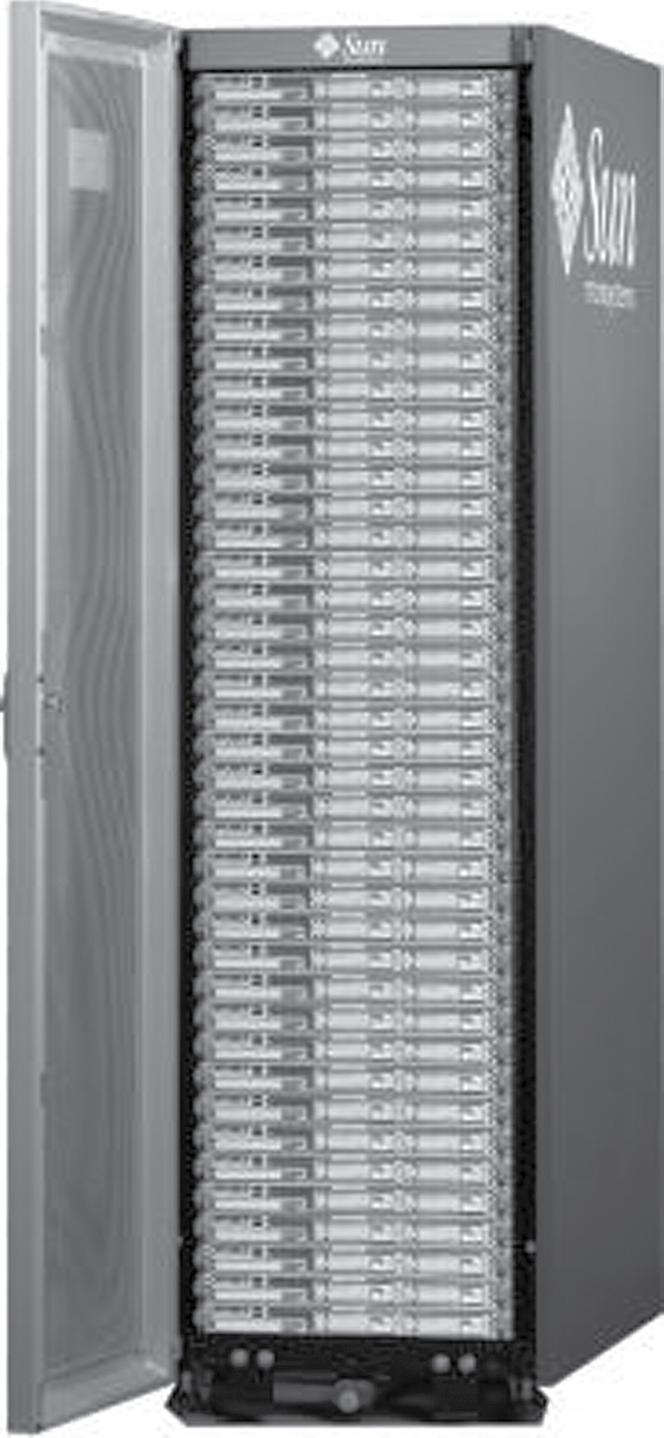
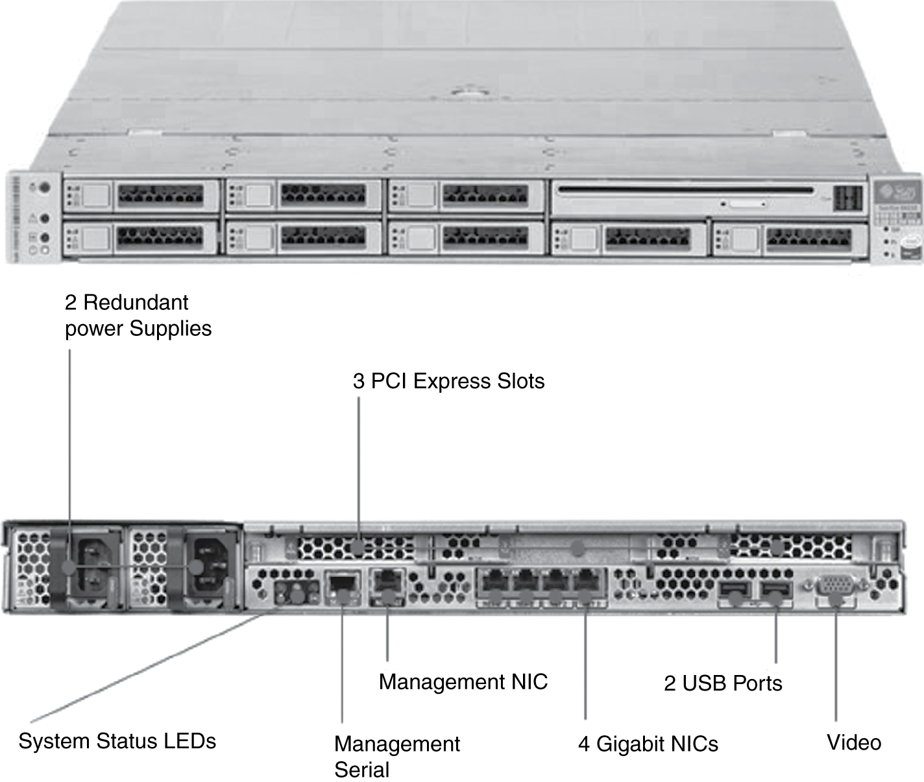
Rack-Mounted Servers
Sun Fire x4150 1U server

Slide 40
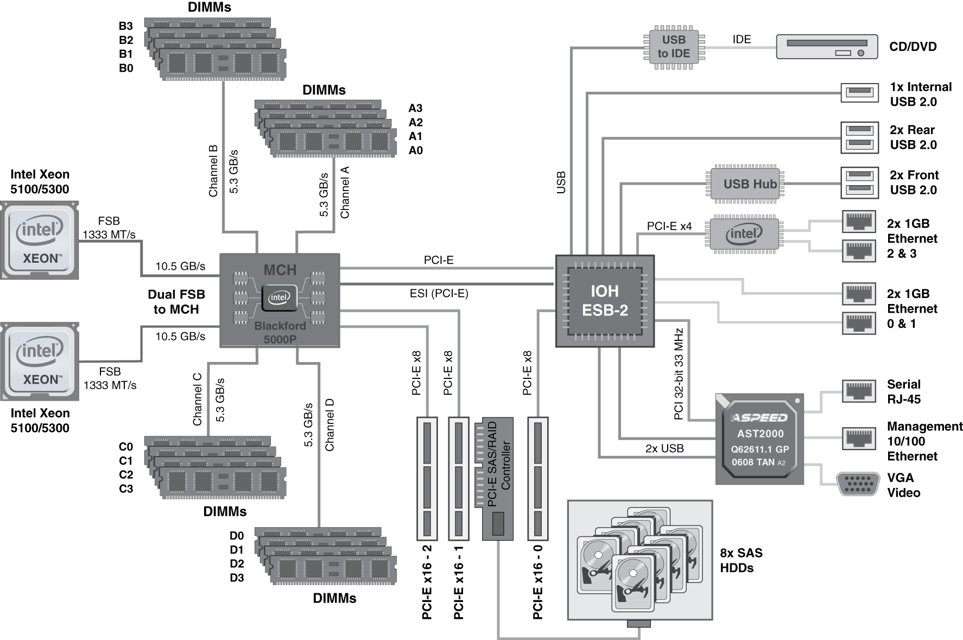
Sun Fire x4150 1U server
4 cores each
16 x 4GB = 64GB DRAM

Slide 41
I/O System Design Example
Given a Sun Fire x4150 system with
  Workload: 64KB disk reads
    Each I/O op requires 200,000 user-code instructions and 100,000 OS instructions
  Each CPU: 10⁹ instructions/sec
  FSB: 10.6 GB/sec peak
  DRAM DDR2 667MHz: 5.336 GB/sec
  PCI-E 8× bus: 8 × 250MB/sec = 2GB/sec
  Disks: 15,000 rpm, 2.9ms avg. seek time, 112MB/sec transfer rate
What I/O rate can be sustained?
  For random reads, and for sequential reads

Slide 42
Design Example (cont)
I/O rate for CPUs
  Per core: 10⁹/(100,000 + 200,000) = 3,333
  8 cores: 26,667 ops/sec
Random reads, I/O rate for disks
  Assume actual seek time is average/4
  Time/op = seek + latency + transfer
  = 2.9ms/4 + 4ms/2 + 64KB/(112MB/s) = 3.3ms
  303 ops/sec per disk, 2424 ops/sec for 8 disks
Sequential reads
  112MB/s / 64KB = 1750 ops/sec per disk
  14,000 ops/sec for 8 disks

Slide 43
Design Example (cont)
PCI-E I/O rate
  2GB/sec / 64KB = 31,250 ops/sec
DRAM I/O rate
  5.336 GB/sec / 64KB = 83,375 ops/sec
FSB I/O rate
  Assume we can sustain half the peak rate
  5.3 GB/sec / 64KB = 81,540 ops/sec per FSB
  163,080 ops/sec for 2 FSBs
Weakest link: disks
  2424 ops/sec random, 14,000 ops/sec sequential
  Other components have ample headroom to accommodate these rates

Slide 44
Fallacy: Disk Dependability
If a disk manufacturer quotes MTTF as 1,200,000hr (140yr)
  A disk will work that long
Wrong: this is the mean time to failure
  What is the distribution of failures?
  What if you have 1000 disks
    How many will fail per year?
§6.12 Fallacies and Pitfalls

Slide 45
Fallacies
Disk failure rates are as specified
  Studies of failure rates in the field
    Schroeder and Gibson: 2% to 4% vs. 0.6% to 0.8%
    Pinheiro, et al.: 1.7% (first year) to 8.6% (third year) vs. 1.5%
  Why?
A 1GB/s interconnect transfers 1GB in one sec
  But what’s a GB?
  For bandwidth, use 1GB = 10⁹ B
  For storage, use 1GB = 2³⁰ B = 1.075×10⁹ B
  So 1GB/sec is 0.93GB in one second
    About 7% error

Slide 46
Pitfall: Offloading to I/O Processors
Overhead of managing I/O processor request may dominate
  Quicker to do small operation on the CPU
  But I/O architecture may prevent that
I/O processor may be slower
  Since it’s supposed to be simpler
Making it faster makes it into a major system component
  Might need its own coprocessors!

Slide 47
Pitfall: Backing Up to Tape
Magnetic tape used to have advantages
  Removable, high capacity
Advantages eroded by disk technology developments
Makes better sense to replicate data
  E.g, RAID, remote mirroring

Slide 48
Fallacy: Disk Scheduling
Best to let the OS schedule disk accesses
  But modern drives deal with logical block addresses
    Map to physical track, cylinder, sector locations
    Also, blocks are cached by the drive
  OS is unaware of physical locations
    Reordering can reduce performance
    Depending on placement and caching

Slide 49
Pitfall: Peak Performance
Peak I/O rates are nearly impossible to achieve
  Usually, some other system component limits performance
  E.g., transfers to memory over a bus
    Collision with DRAM refresh
    Arbitration contention with other bus masters
  E.g., PCI bus: peak bandwidth ~133 MB/sec
    In practice, max 80MB/sec sustainable

Slide 50
Concluding Remarks
I/O performance measures
  Throughput, response time
  Dependability and cost also important
Buses used to connect CPU, memory,
I/O controllers
  Polling, interrupts, DMA
I/O benchmarks
  TPC, SPECSFS, SPECWeb
RAID
  Improves performance and dependability
§6.13 Concluding Remarks

